Slide 1
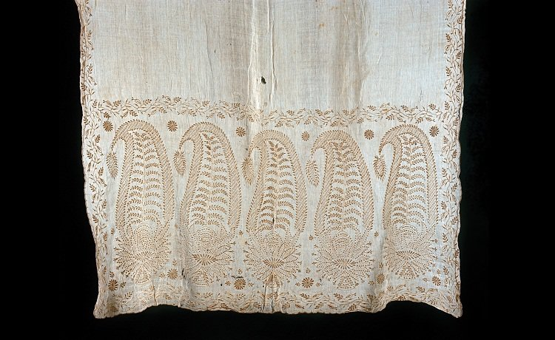
Black
Red, White, and Make Blue : Indigo in the Fabric of Colonial South Carolina Life
Andrea Feeser
Silk wrap with indigo plant design made by Eliza Lucas Pinckney around 1752

Slide 2
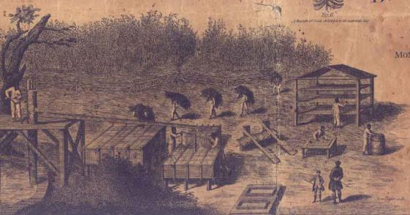
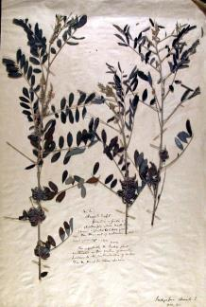
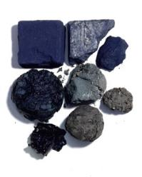
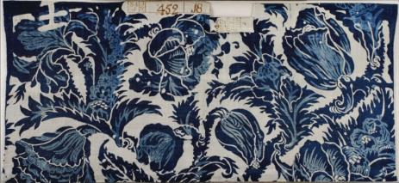
Illustration from Henry Mouzon Jr., A Map of the Parish of St. Stephen, in Craven County, 1773
1840 South Carolina indigo specimen collected from a field formerly planted with the crop
Indigo dye cakes
Eighteenth-century
English indigo-dyed
cloth

Slide 3
Indian, merchant-planters, and slave carting packed indigo dye cakes for export

Slide 4
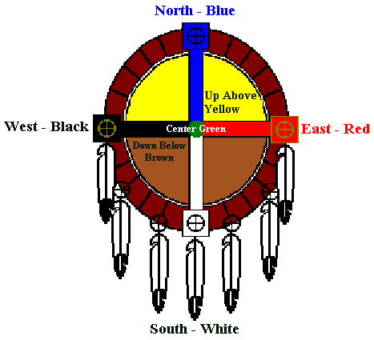
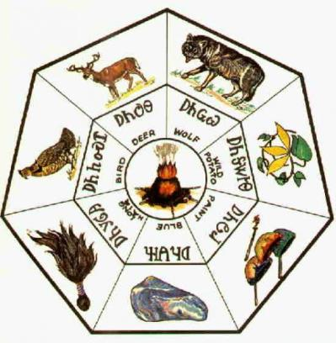
The Cherokee four directions and seven clans

Slide 5
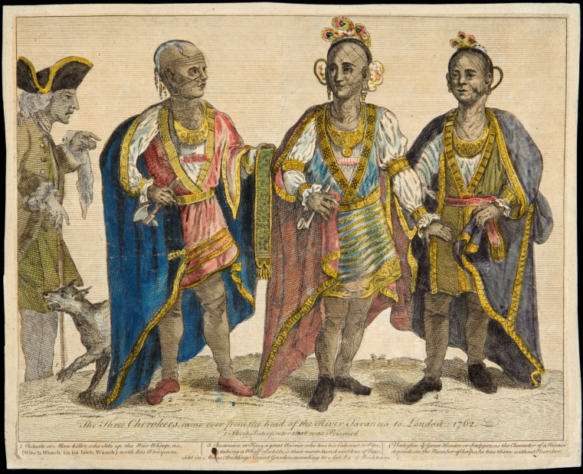
George Bickham, Three Cherokees Came over from the Head of the River Savanna to London, 1762

Slide 6
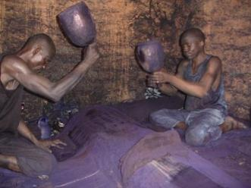
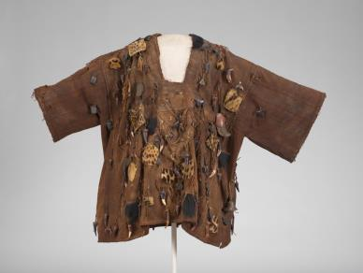
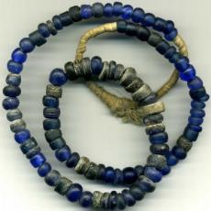
Hausa men pounding powdered indigo into indigo-dyed cloth, Nigeria
A nineteenth- or early twentieth-century
Bamana hunting shirt from Mali
Eighteenth-century trade beads like those excavated from North American slave sites

Slide 7
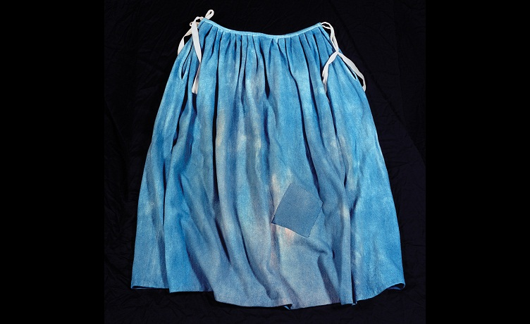
Reproduction eighteenth-century slave skirt dyed with indigo, created by Kendra Johnson

Slide 8
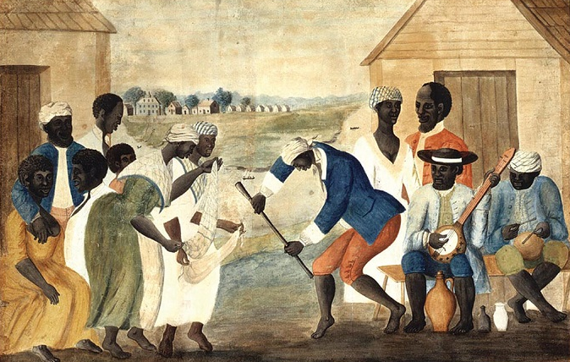
John Rose, The Old Plantation, Beaufort County, South Carolina, 1785-90

